Slide 1


VibeDesk: AI-Powered Emotion-Adaptive Workspace
Team ID : TM-01-047
Team Name : Strange Coders
Team Members : 1) G Sai Santosh Reddy
2) D Balaji
3) B Neeraj Kumar

Slide 2
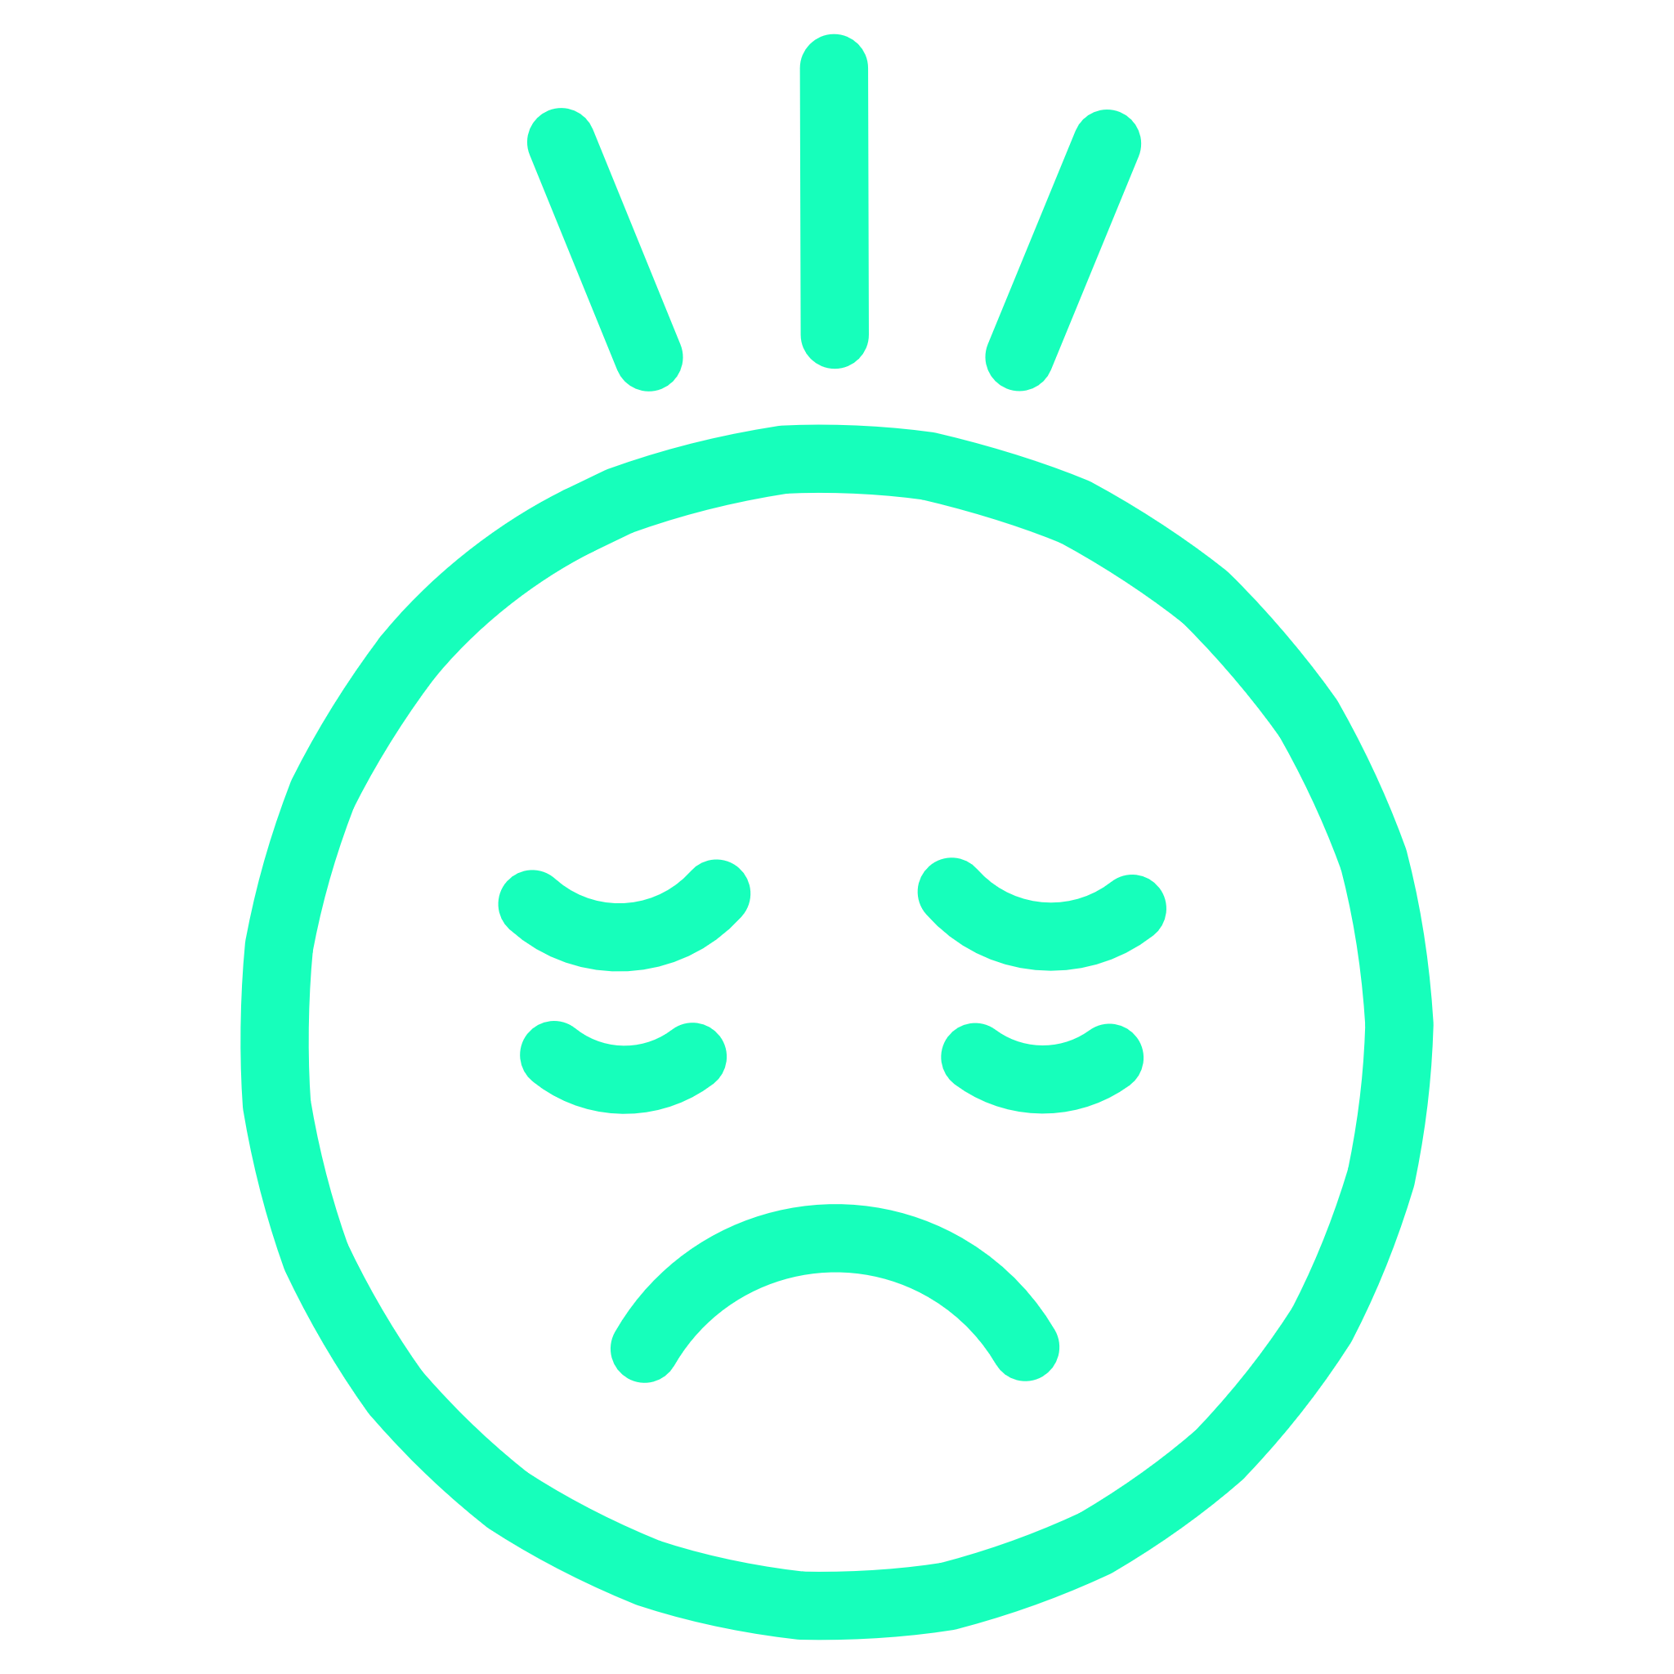


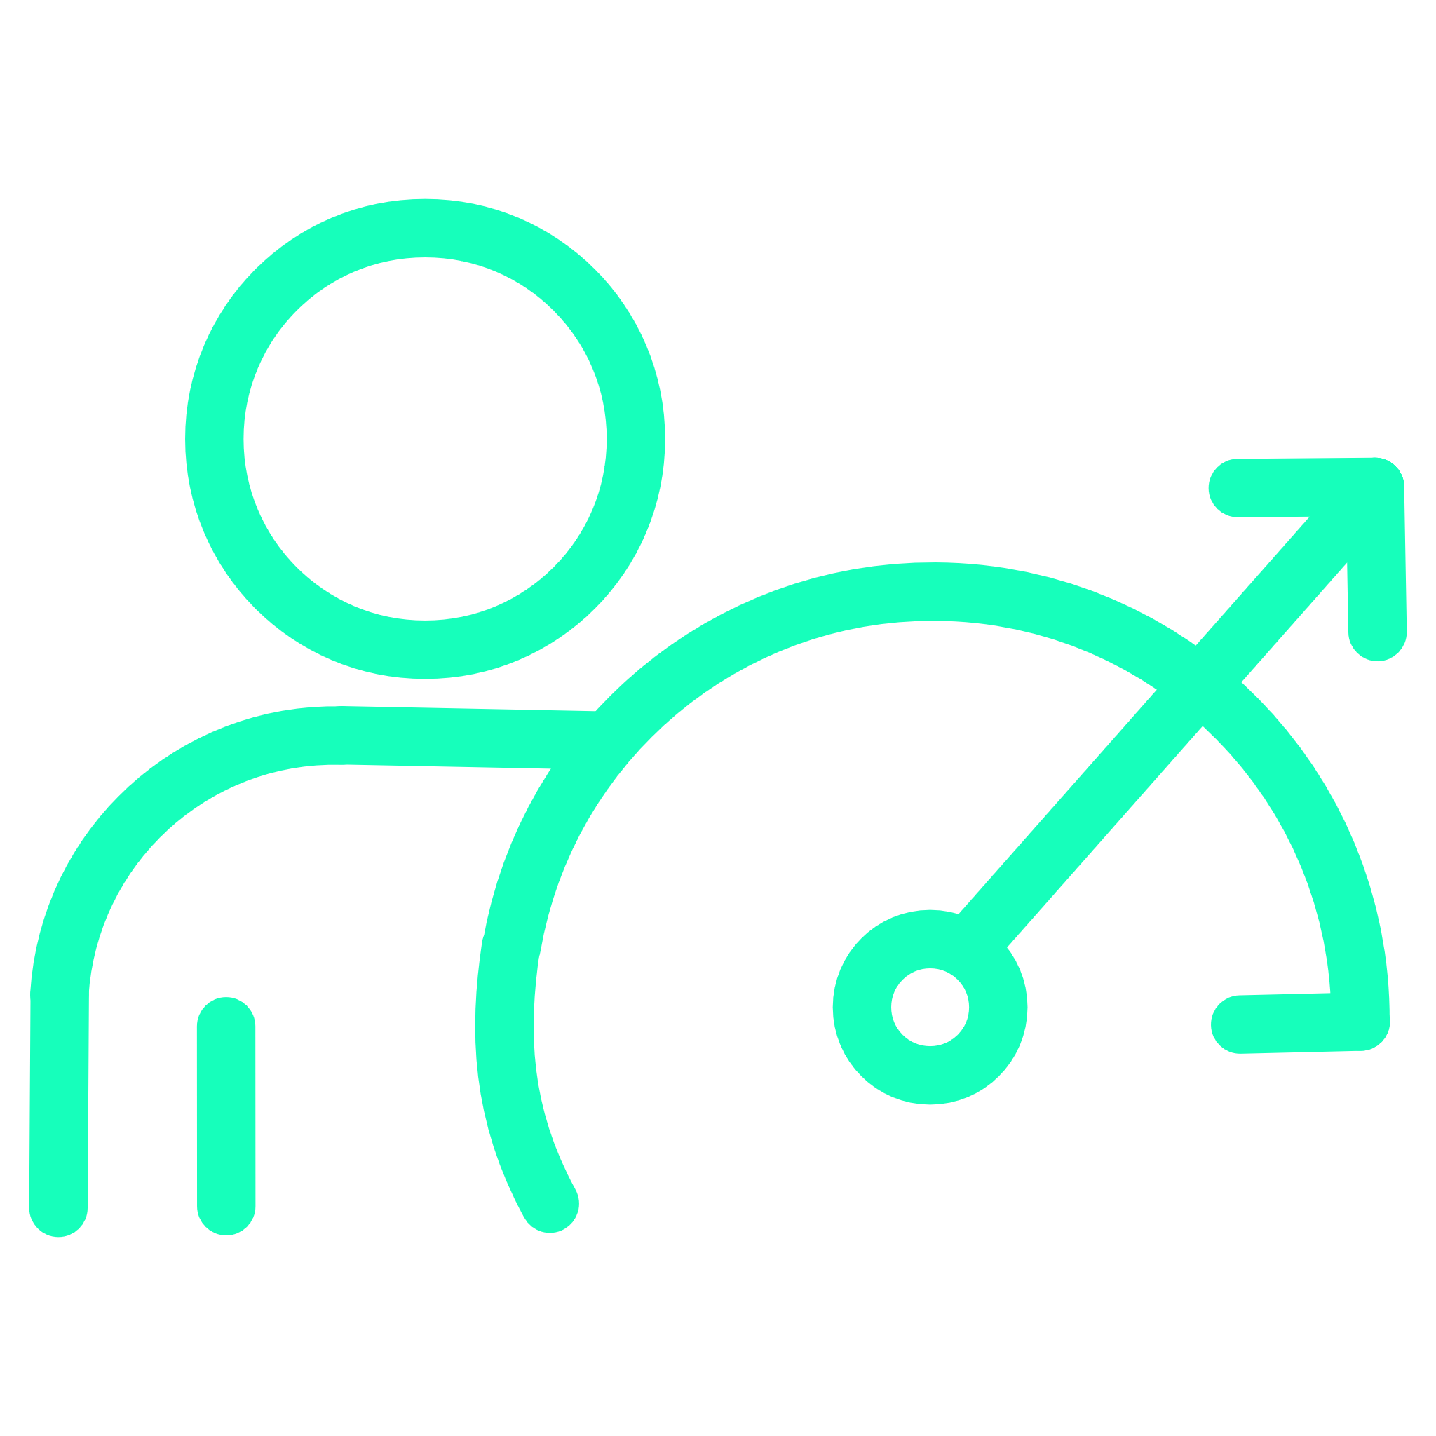
The Unseen Challenge: Our Emotional Workday
Traditional productivity tools operate on a flawed assumption: that users are always in a stable emotional state. However, real-world emotions significantly impact performance and well-being.
Stress & Fatigue
Sadness & Anger
Leads to mental block, errors, and exhaustion.
Diverts focus, reduces motivation, and strains collaboration.
Mismatched Tools
Reduced Efficiency
Generic interfaces fail to adapt, causing burnout and procrastination.
The cumulative effect of emotional friction hampers overall output.

Slide 3


Why This Problem Matters
Students & professionals struggle because tools don't react to their mood. Digital tools must adapt to the human mind, not the other way around.
When Stressed
When Energetic
Cluttered UI makes things worse
Minimal UI limits productivity
Cognitive overload increases errors
Restricted tools reduce output
Burnout accelerates
Potential goes untapped

Slide 4


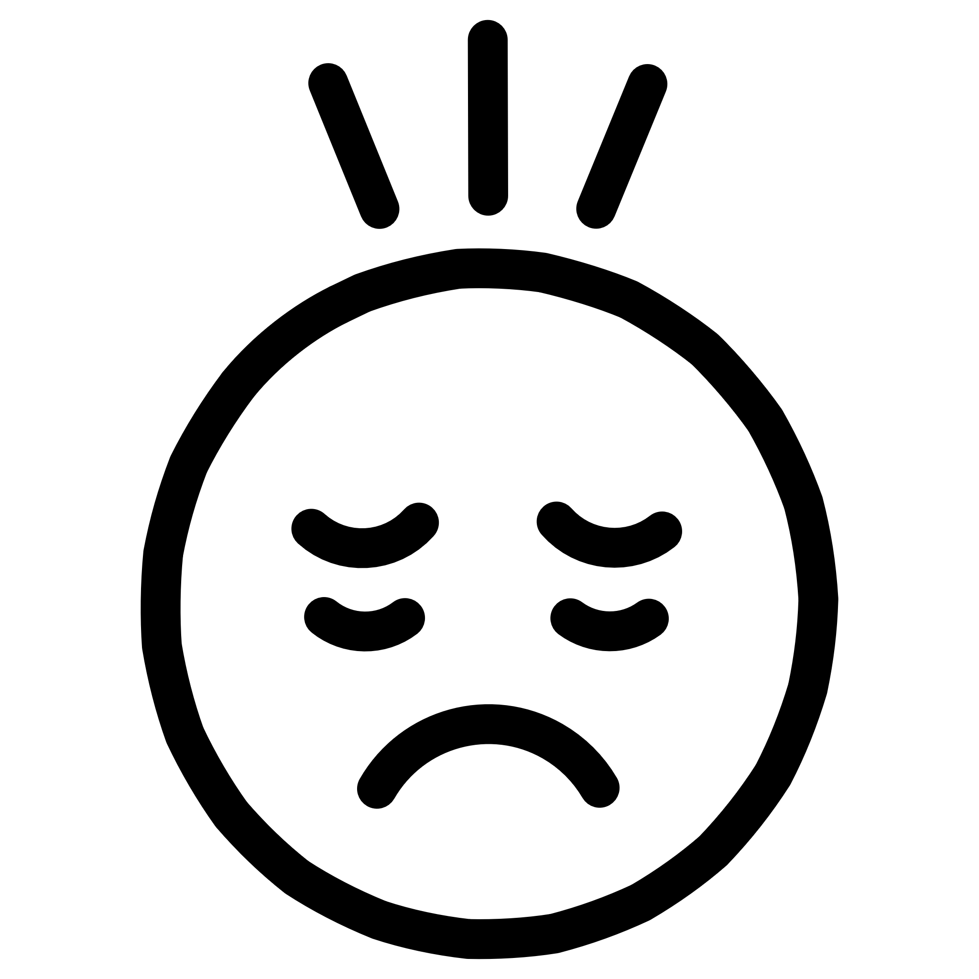

The 5 Core Mood Types
VibeDesk intelligently identifies and adapts to your emotional state, providing a truly personalized workspace experience.
Happy
Angry
Sad
Positive energy, optimism, and motivation. VibeDesk amplifies focus and provides uplifting cues.
Frustration, irritability, and intensity. VibeDesk suggests calming exercises and gentle transitions.
Low mood, melancholy, and need for support. VibeDesk offers empathetic check-ins and resource suggestions.
Stressed
Tired
Overwhelm, pressure, and anxiety. VibeDesk guides breaks, prioritizes tasks, and reduces distractions.
Fatigue, low energy, and need for rest. VibeDesk recommends micro-breaks and adjusts screen settings for comfort.

Slide 5
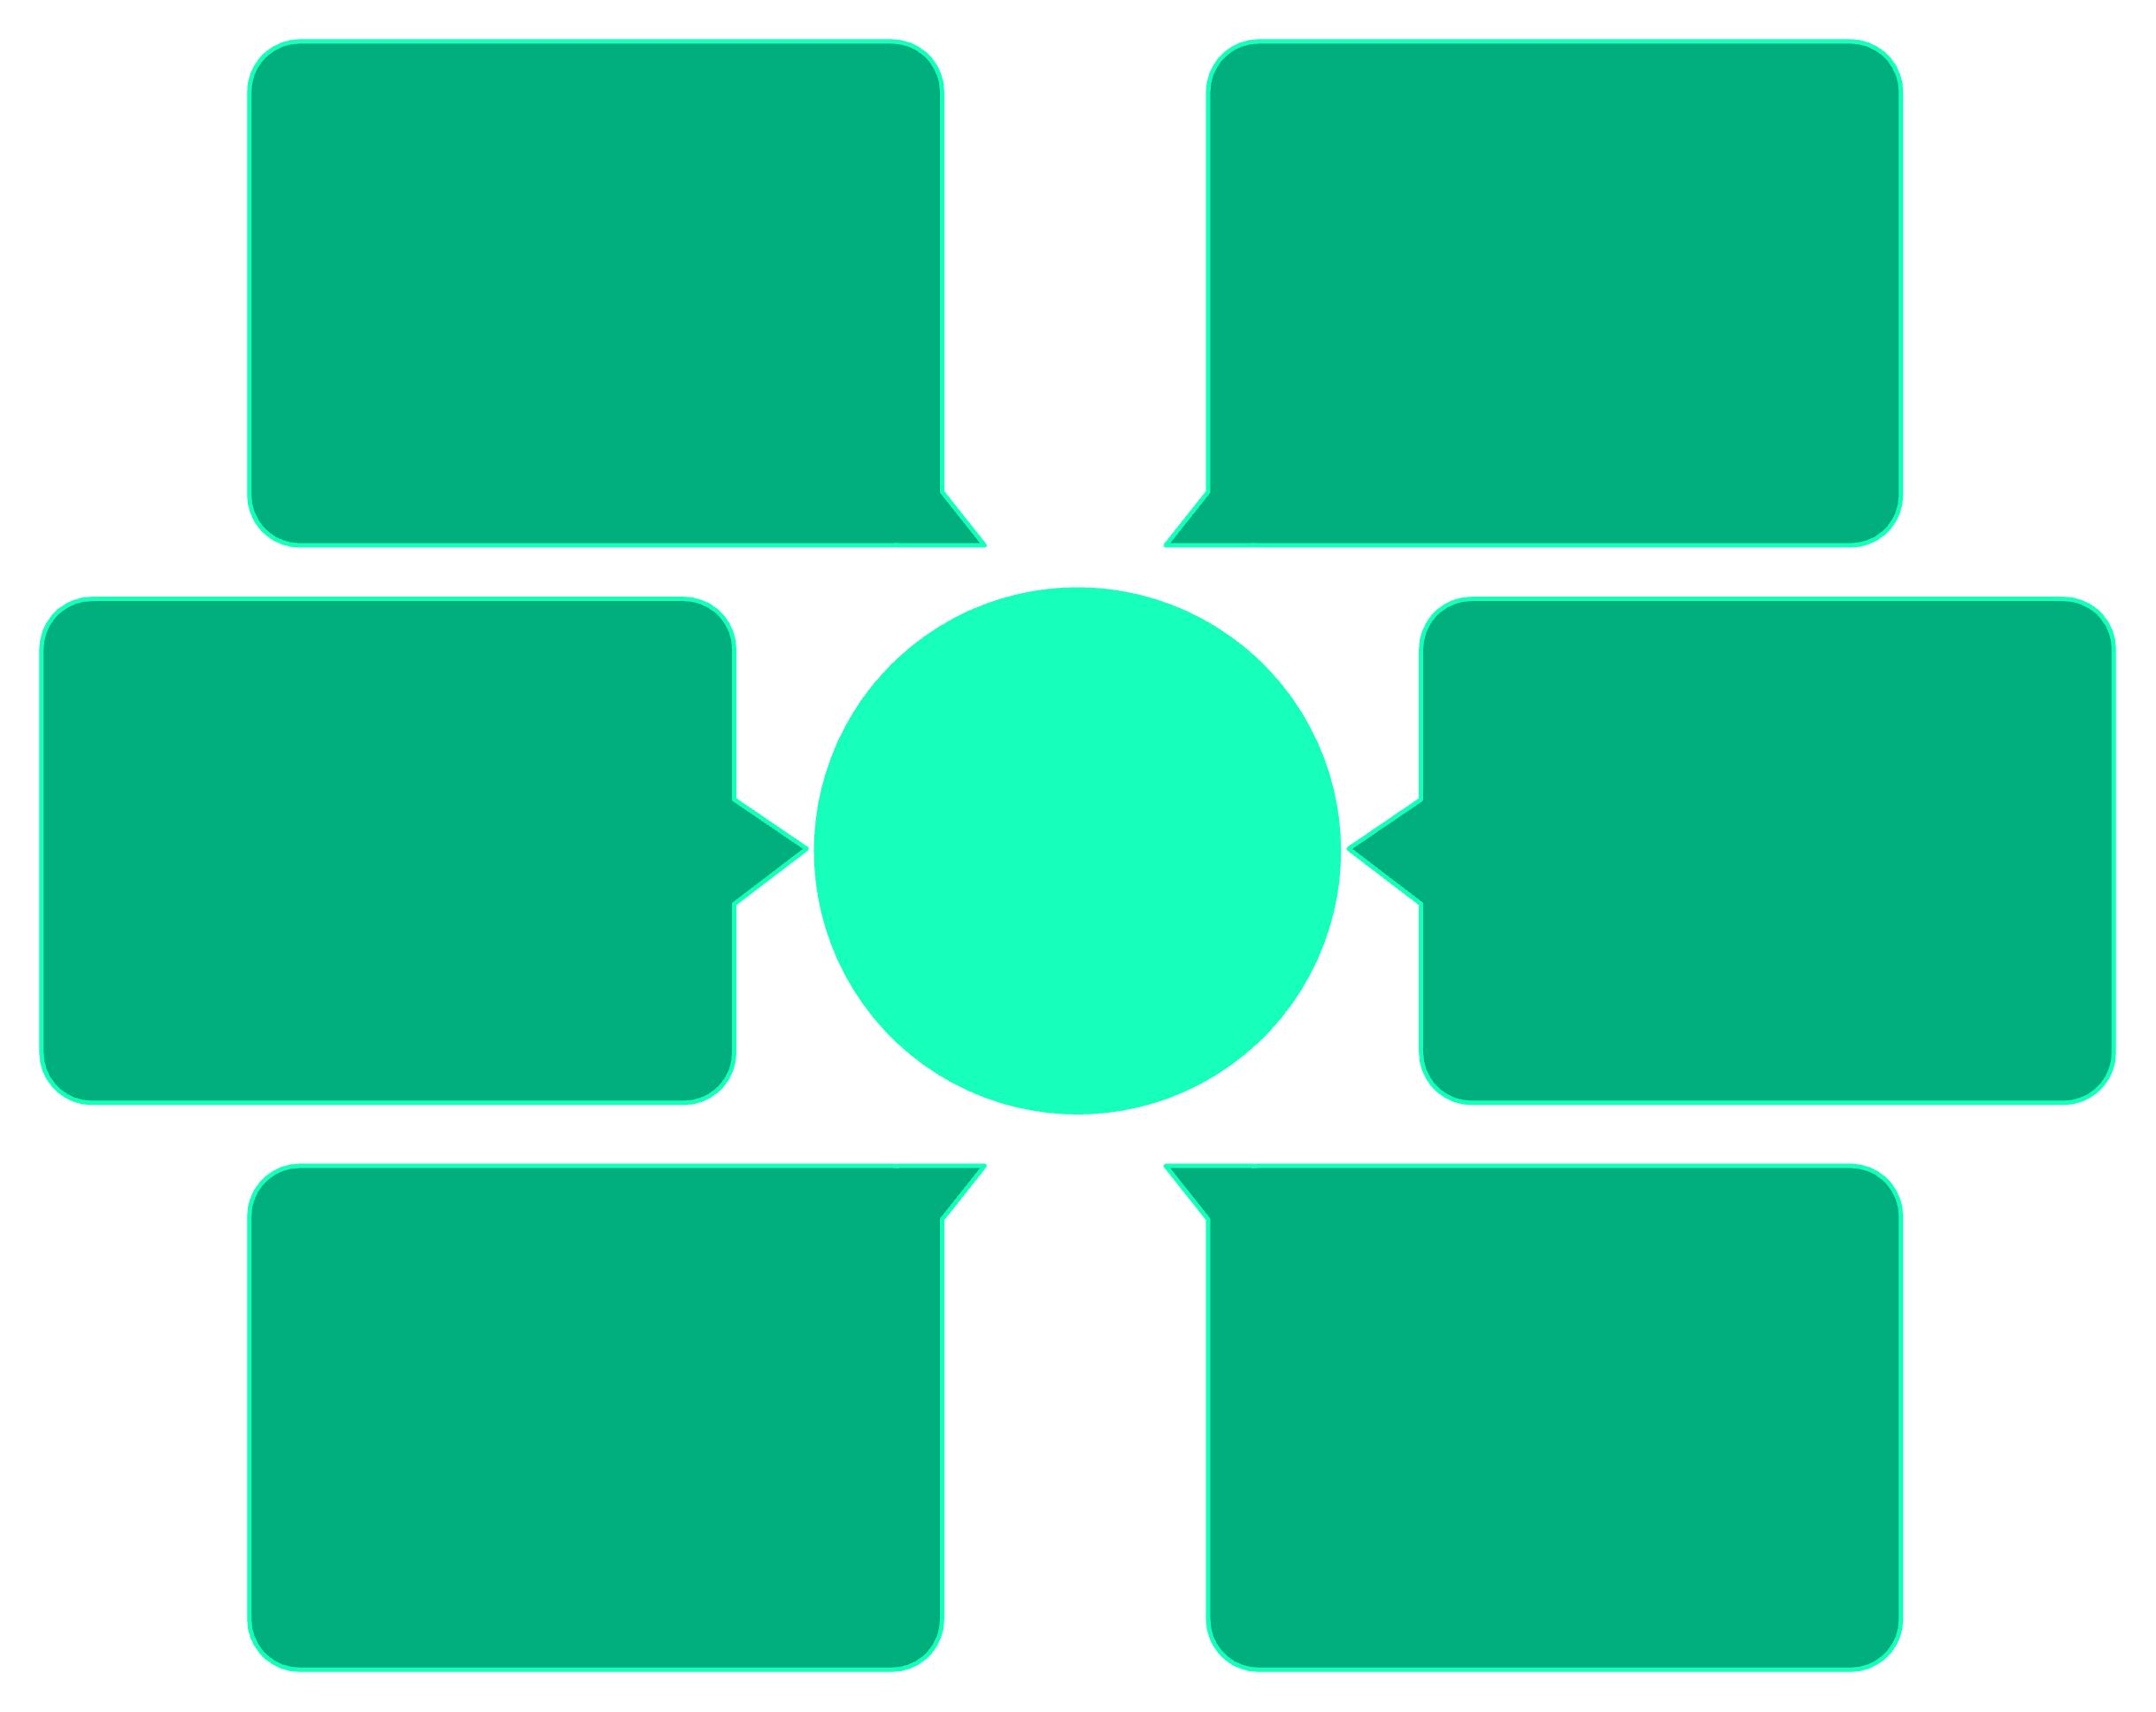
Introducing VibeDesk: Your Adaptive Workspace
VibeDesk is an innovative, multimodal AI-powered adaptive workspace designed to transform in real-time based on your emotional state.
Tools, animations & assistant
User text input
Contextual tools and behavior
Typed messages and notes
Adaptive UI adjustments
User voice input
VibeDesk Adaptive Workspace
Layout and theme changes
Spoken tone and emotion
Gemini 2.5 Flash analysis
User image input
Multimodal intent and mood
Photos and screen captures
Leveraging Google Gemini 2.5 Flash, VibeDesk analyses text, voice, and images to dynamically adjust its user interface, tool availability, animations, and the behaviour of its integrated AI assistant.

Slide 6

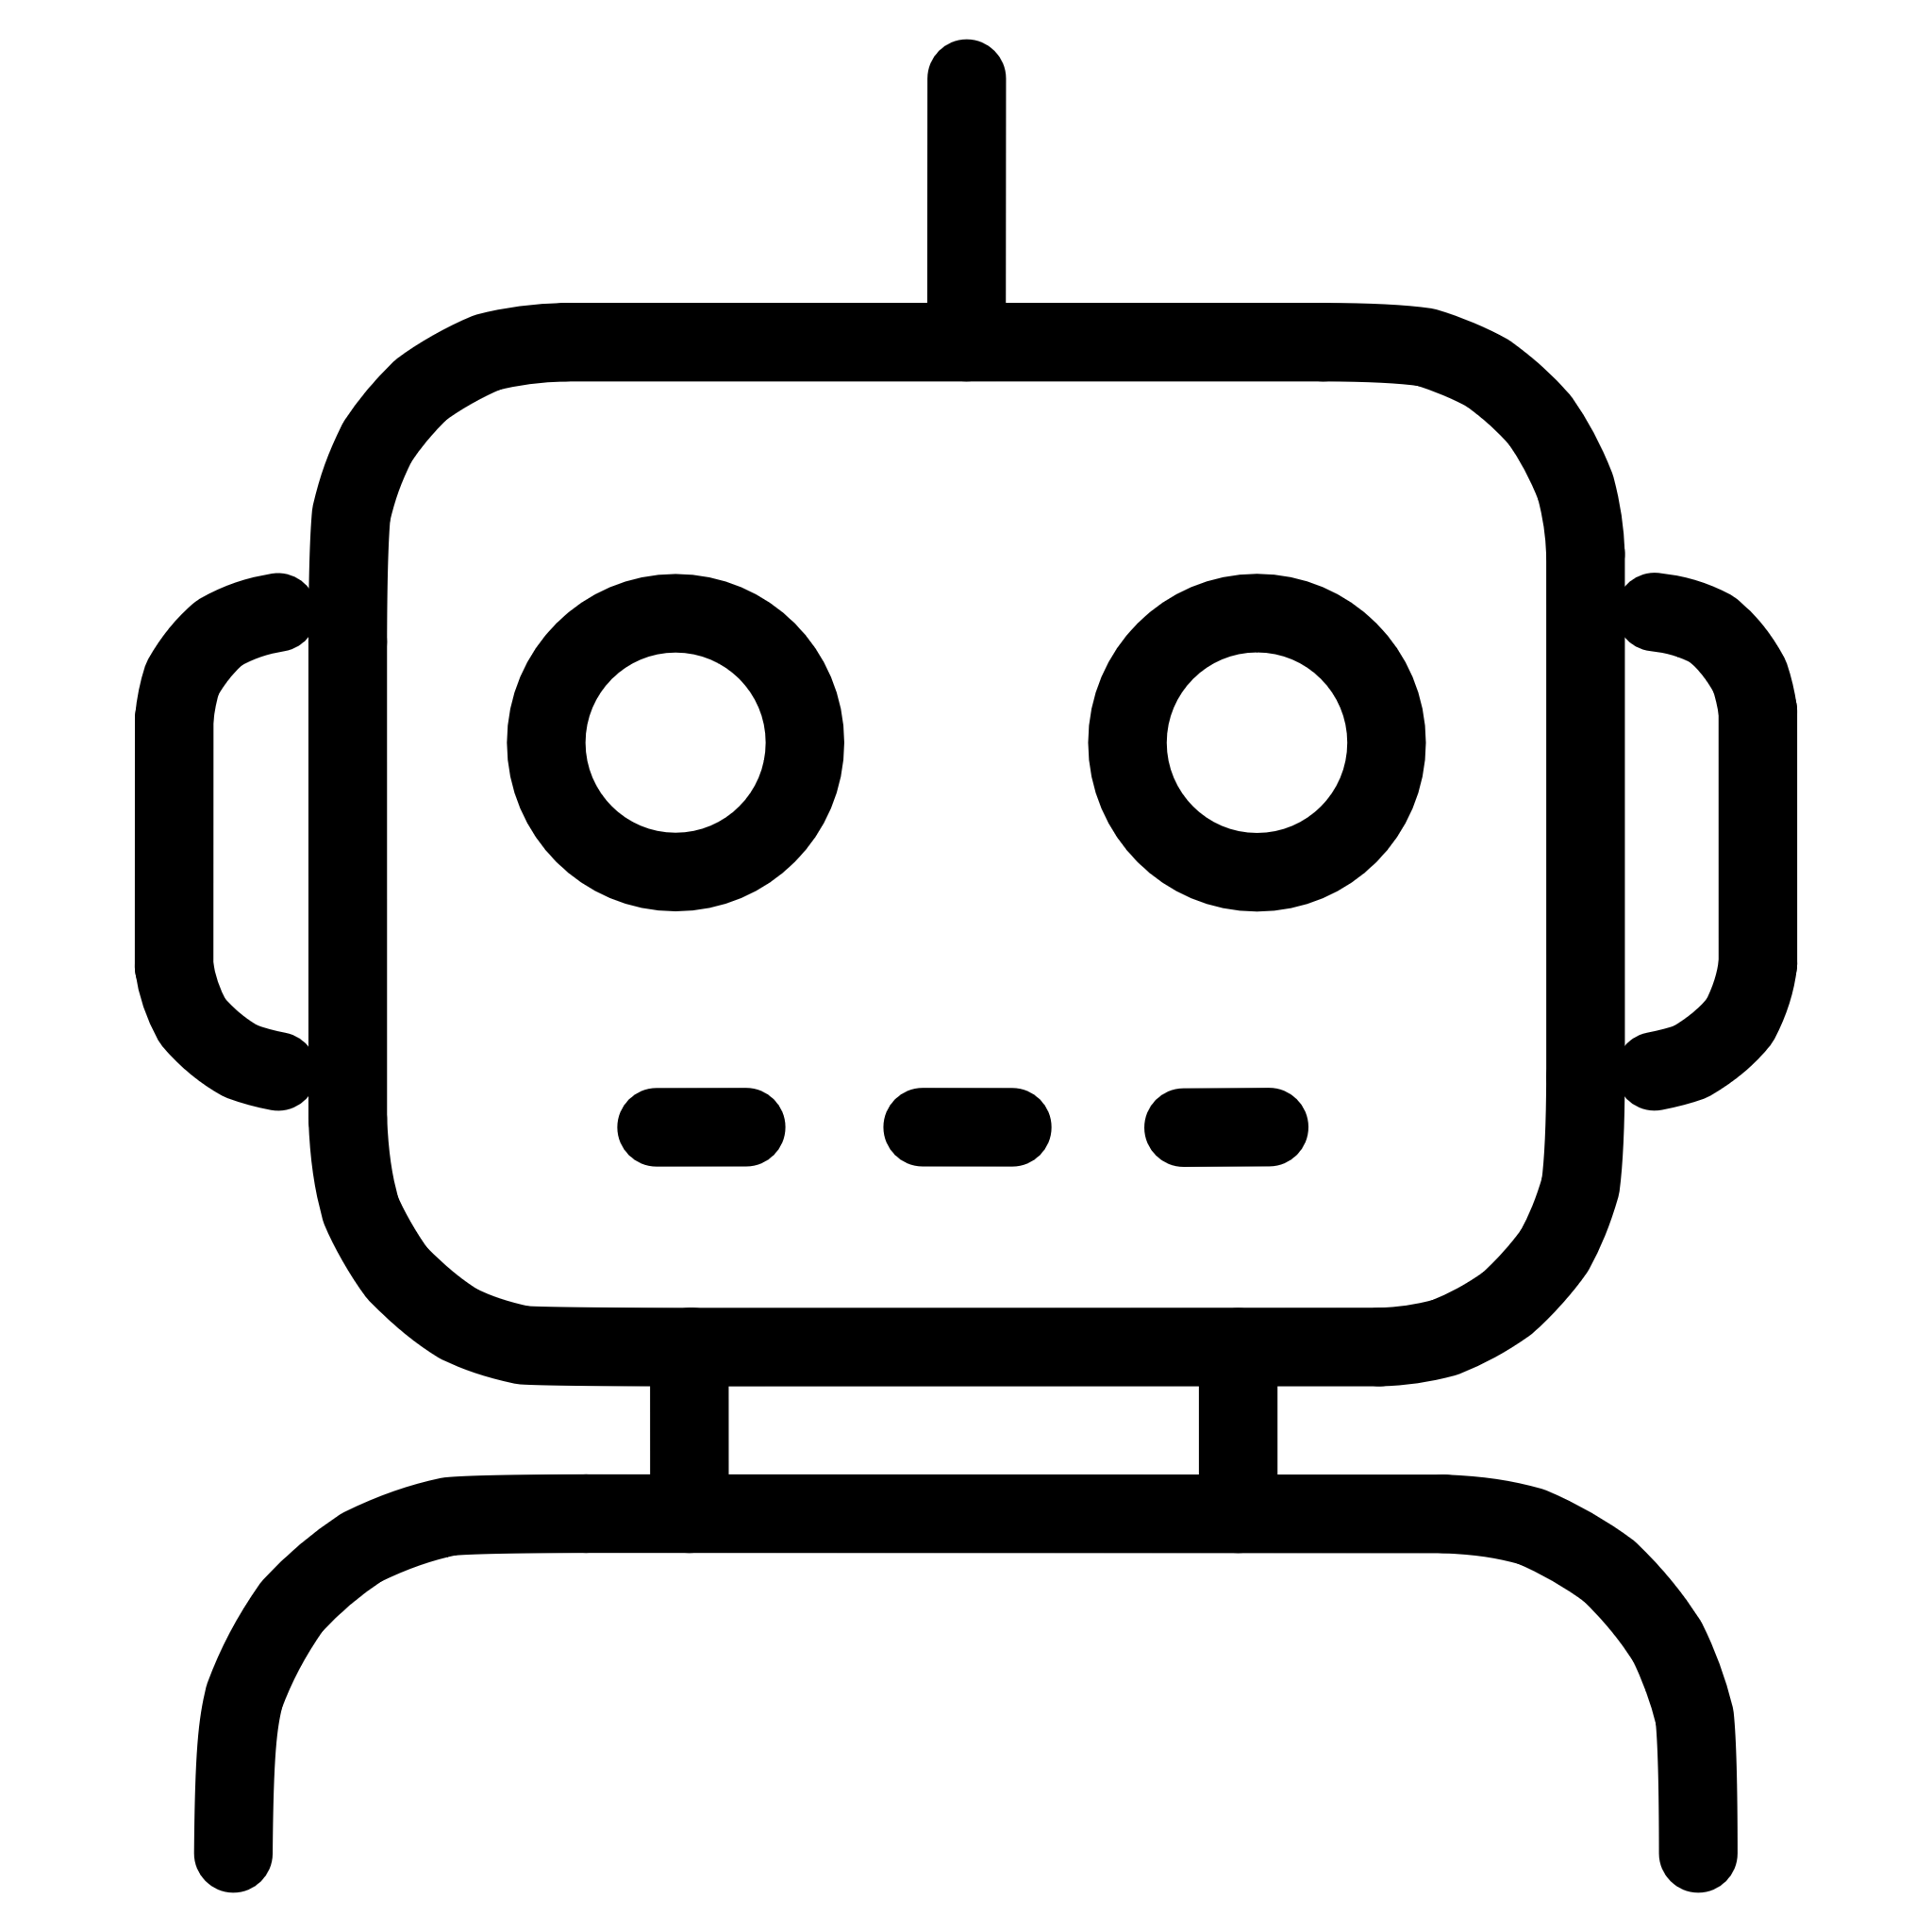

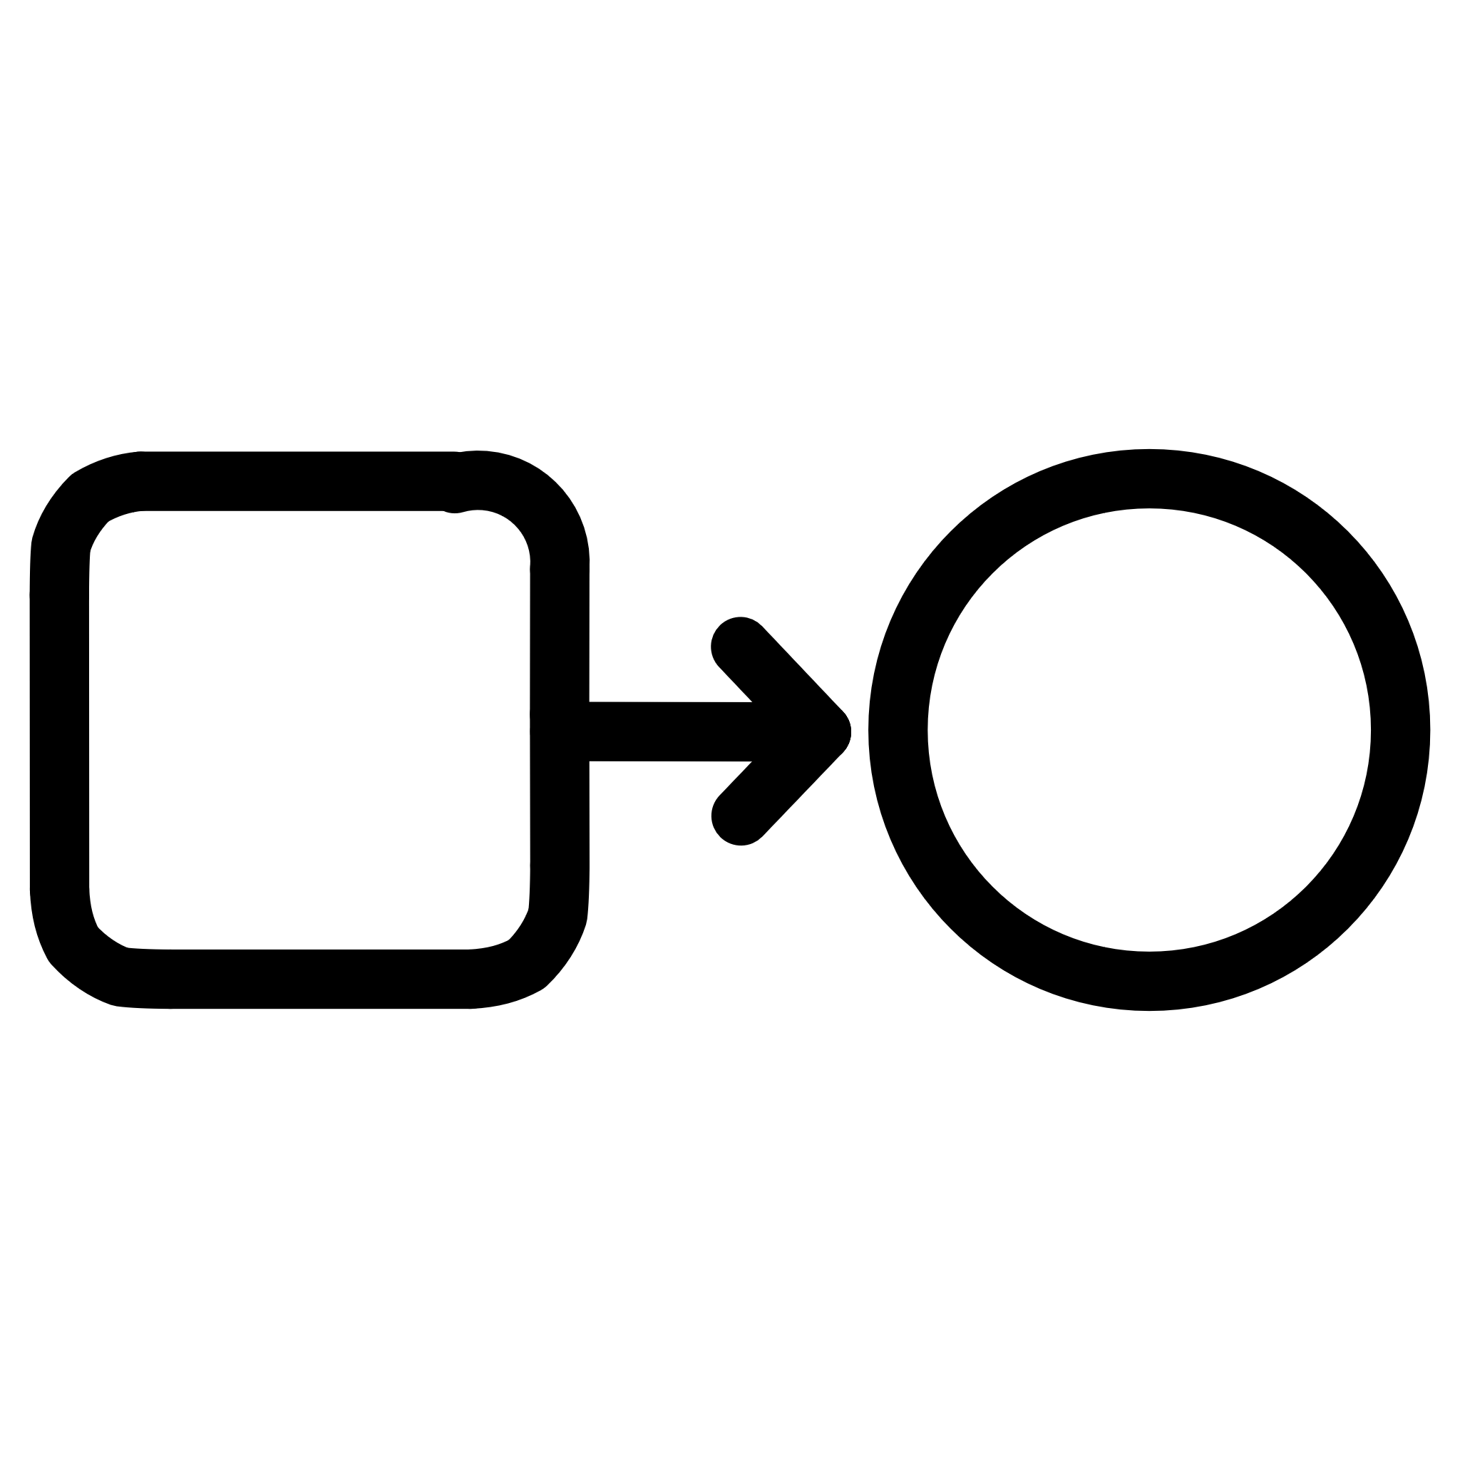
Key Features: Orchestrating Emotional Harmony
Real-time Emotion Detection
Adaptive UI & Themes
VibeCoach AI Assistant
Analyses text, audio, and image inputs for accurate mood insights.
Dynamic adjustments to colours, layouts, and animations based on detected vibe.
An emotion-aware AI providing tailored guidance and support.
Integrated Productivity Tools
Mood-Responsive Transitions
Includes Pomodoro, Kanban, Habit Tracker, Schedule, and an offline music player.
Seamless visual changes powered by Framer Motion for a fluid experience.

Slide 7
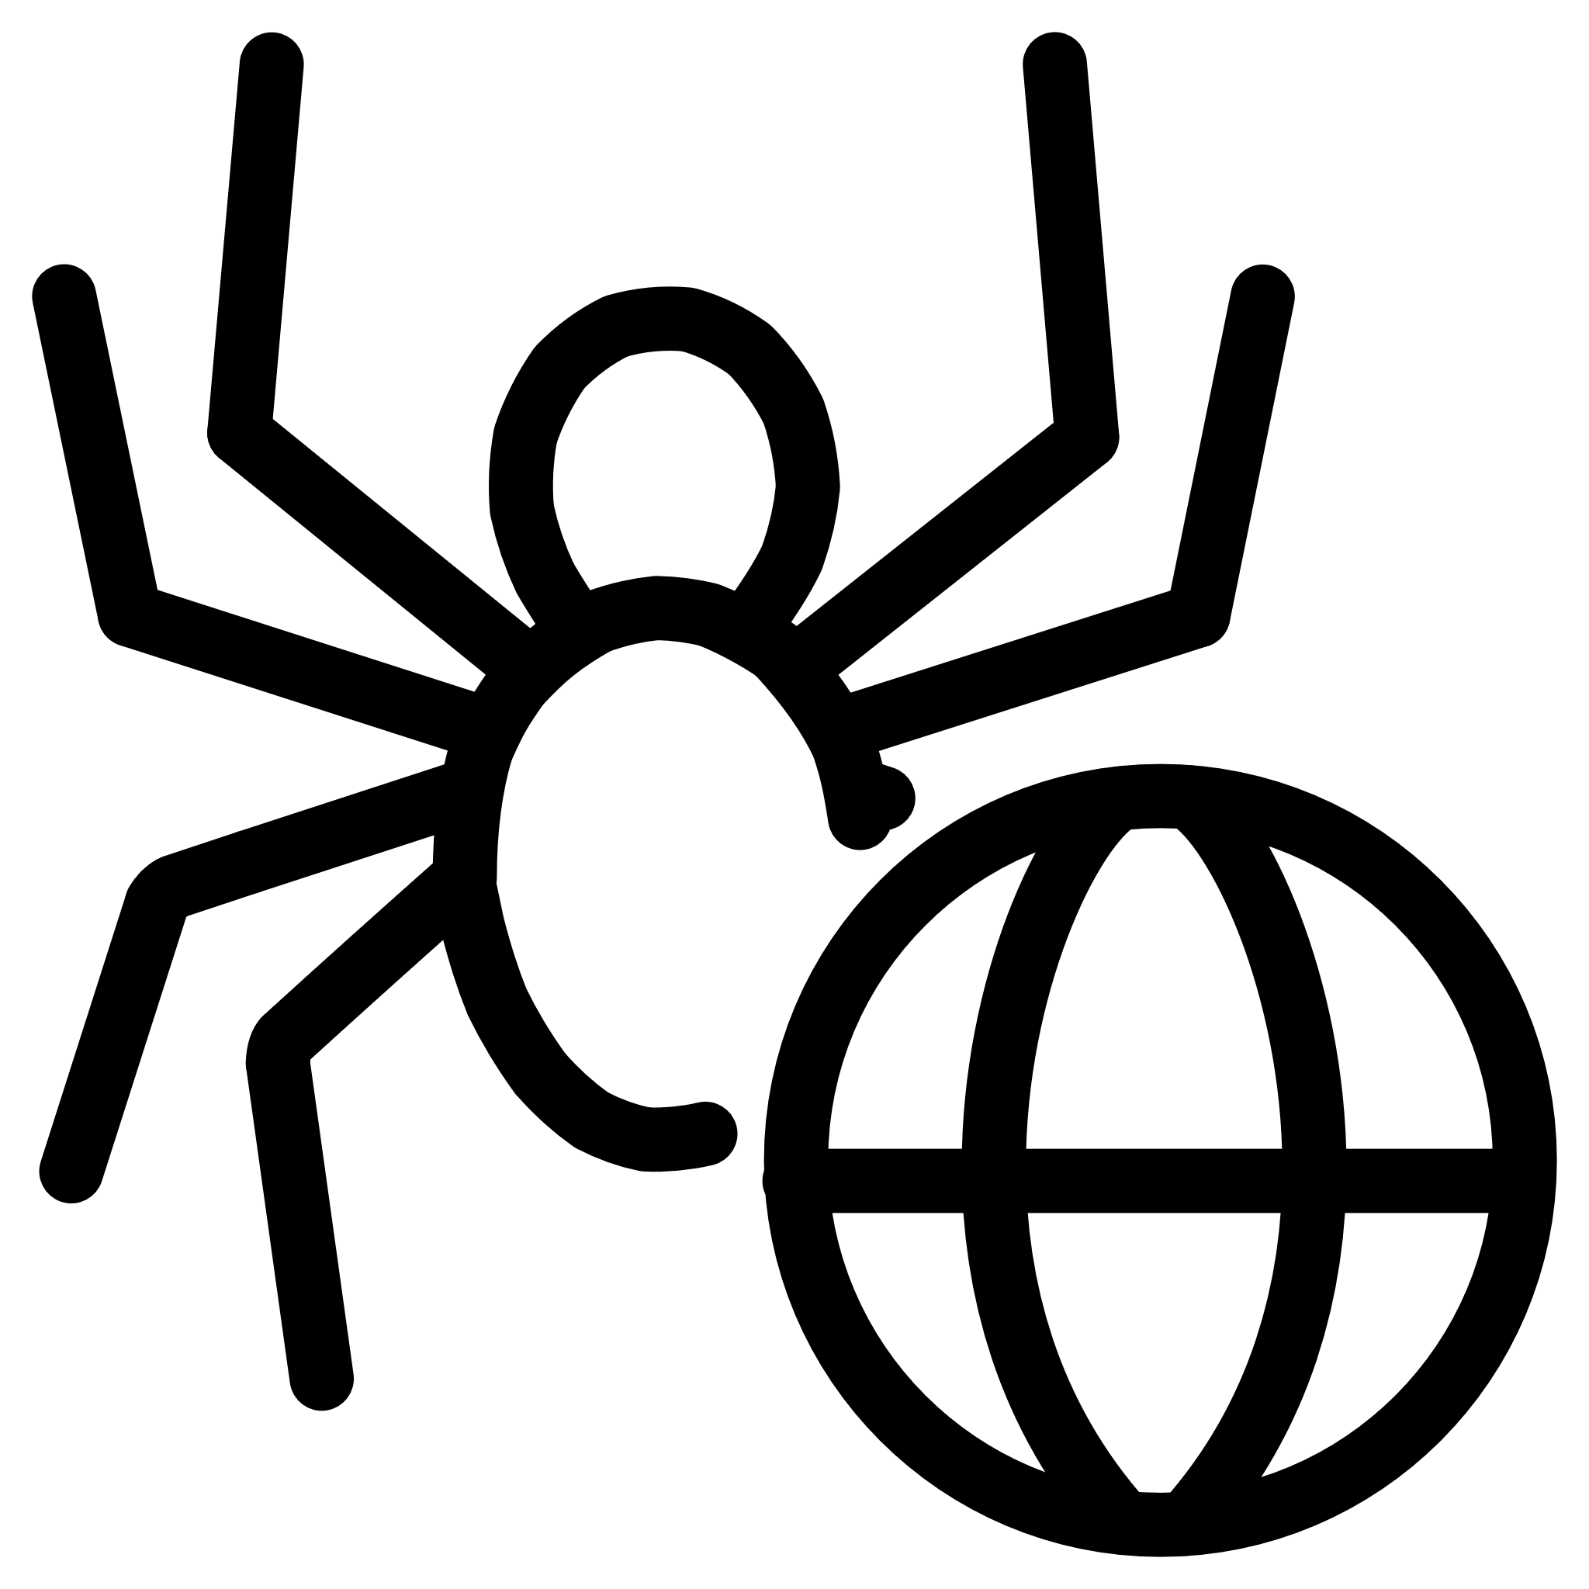
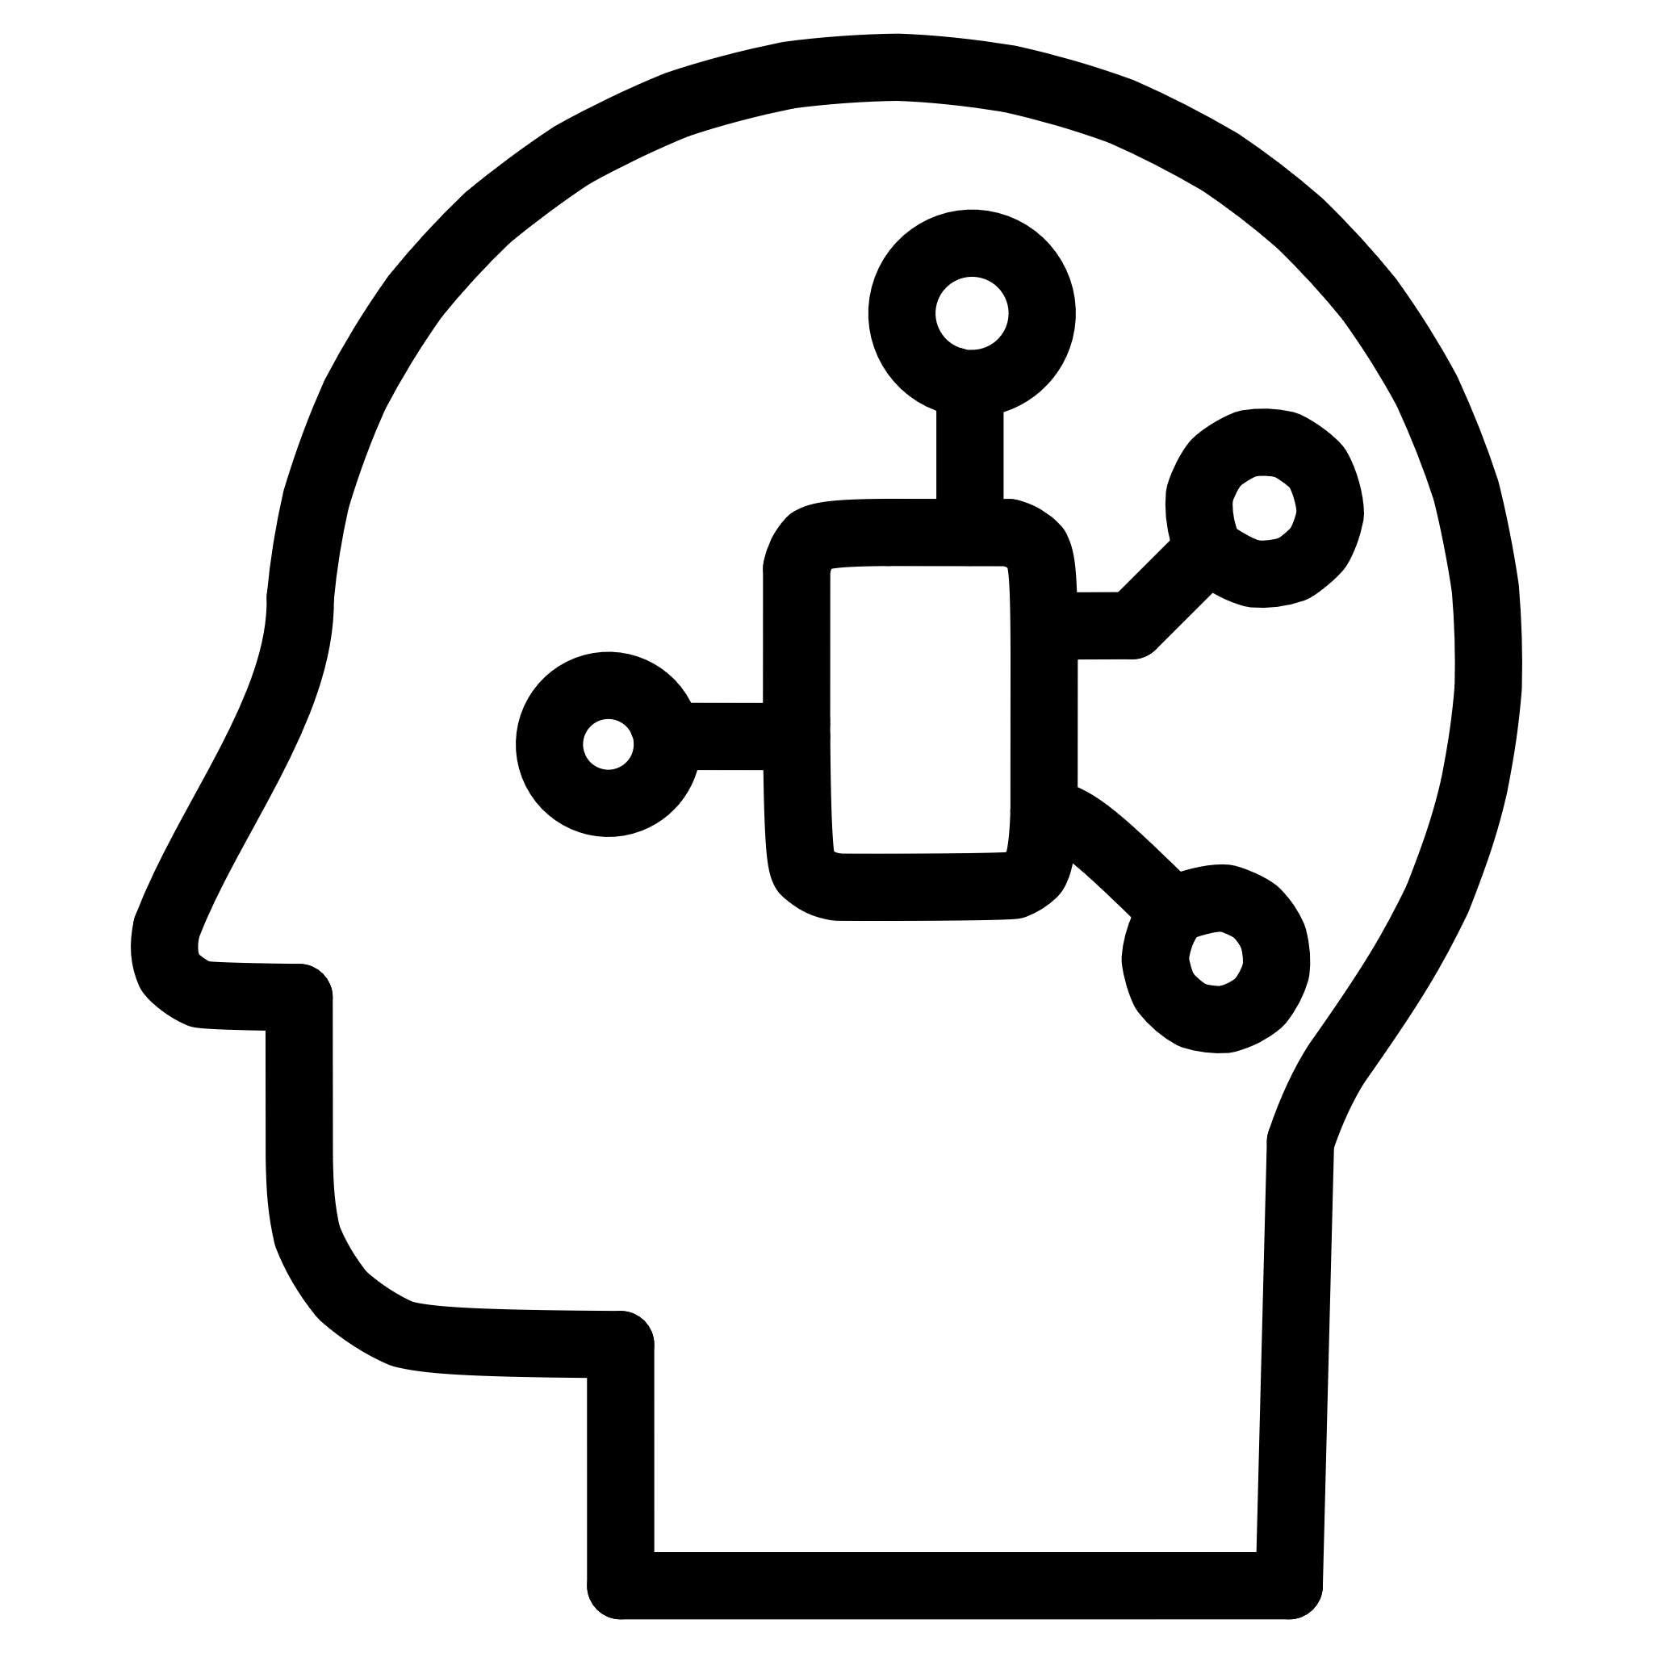


How We Built VibeDesk (Tech + Coding Overview)
Frontend Development
AI & Emotion Processing
React 19 for building component-based UI
Google Gemini 2.5 Flash used for:
TypeScript to ensure type safety and fewer bugs
Text sentiment analysis
Tailwind CSS for fast, responsive design
Voice tone detection
Framer Motion for page transitions and mood animations
Image-based emotion recognition
API responses dynamically modify UI states
Backend & Storage
Code Highlights
Firebase Authentication → secure login
Custom hooks for mood-state management (useMood())
Firestore DB → save tasks, habits, user settings
Adaptive theme engine (auto-switch colors based on emotion)
IndexedDB → offline support for music + local caching
Modular architecture for scalability
Web Audio API → responsive offline music player

Slide 8
Expected Outcomes: A Healthier, More Productive You
VibeDesk isn't just about adapting; it's about empowering users to achieve better well-being and productivity.
25%
30%
40%
↑
Reduced Burnout
Increased Focus
Enhanced Productivity
Digital Wellbeing
Proactive emotional adaptation prevents overwhelm.
Distraction-free modes tailored to your needs.
Optimal tools and UI for every emotional state.
Fostering healthier habits and a balanced work-life.

Slide 9
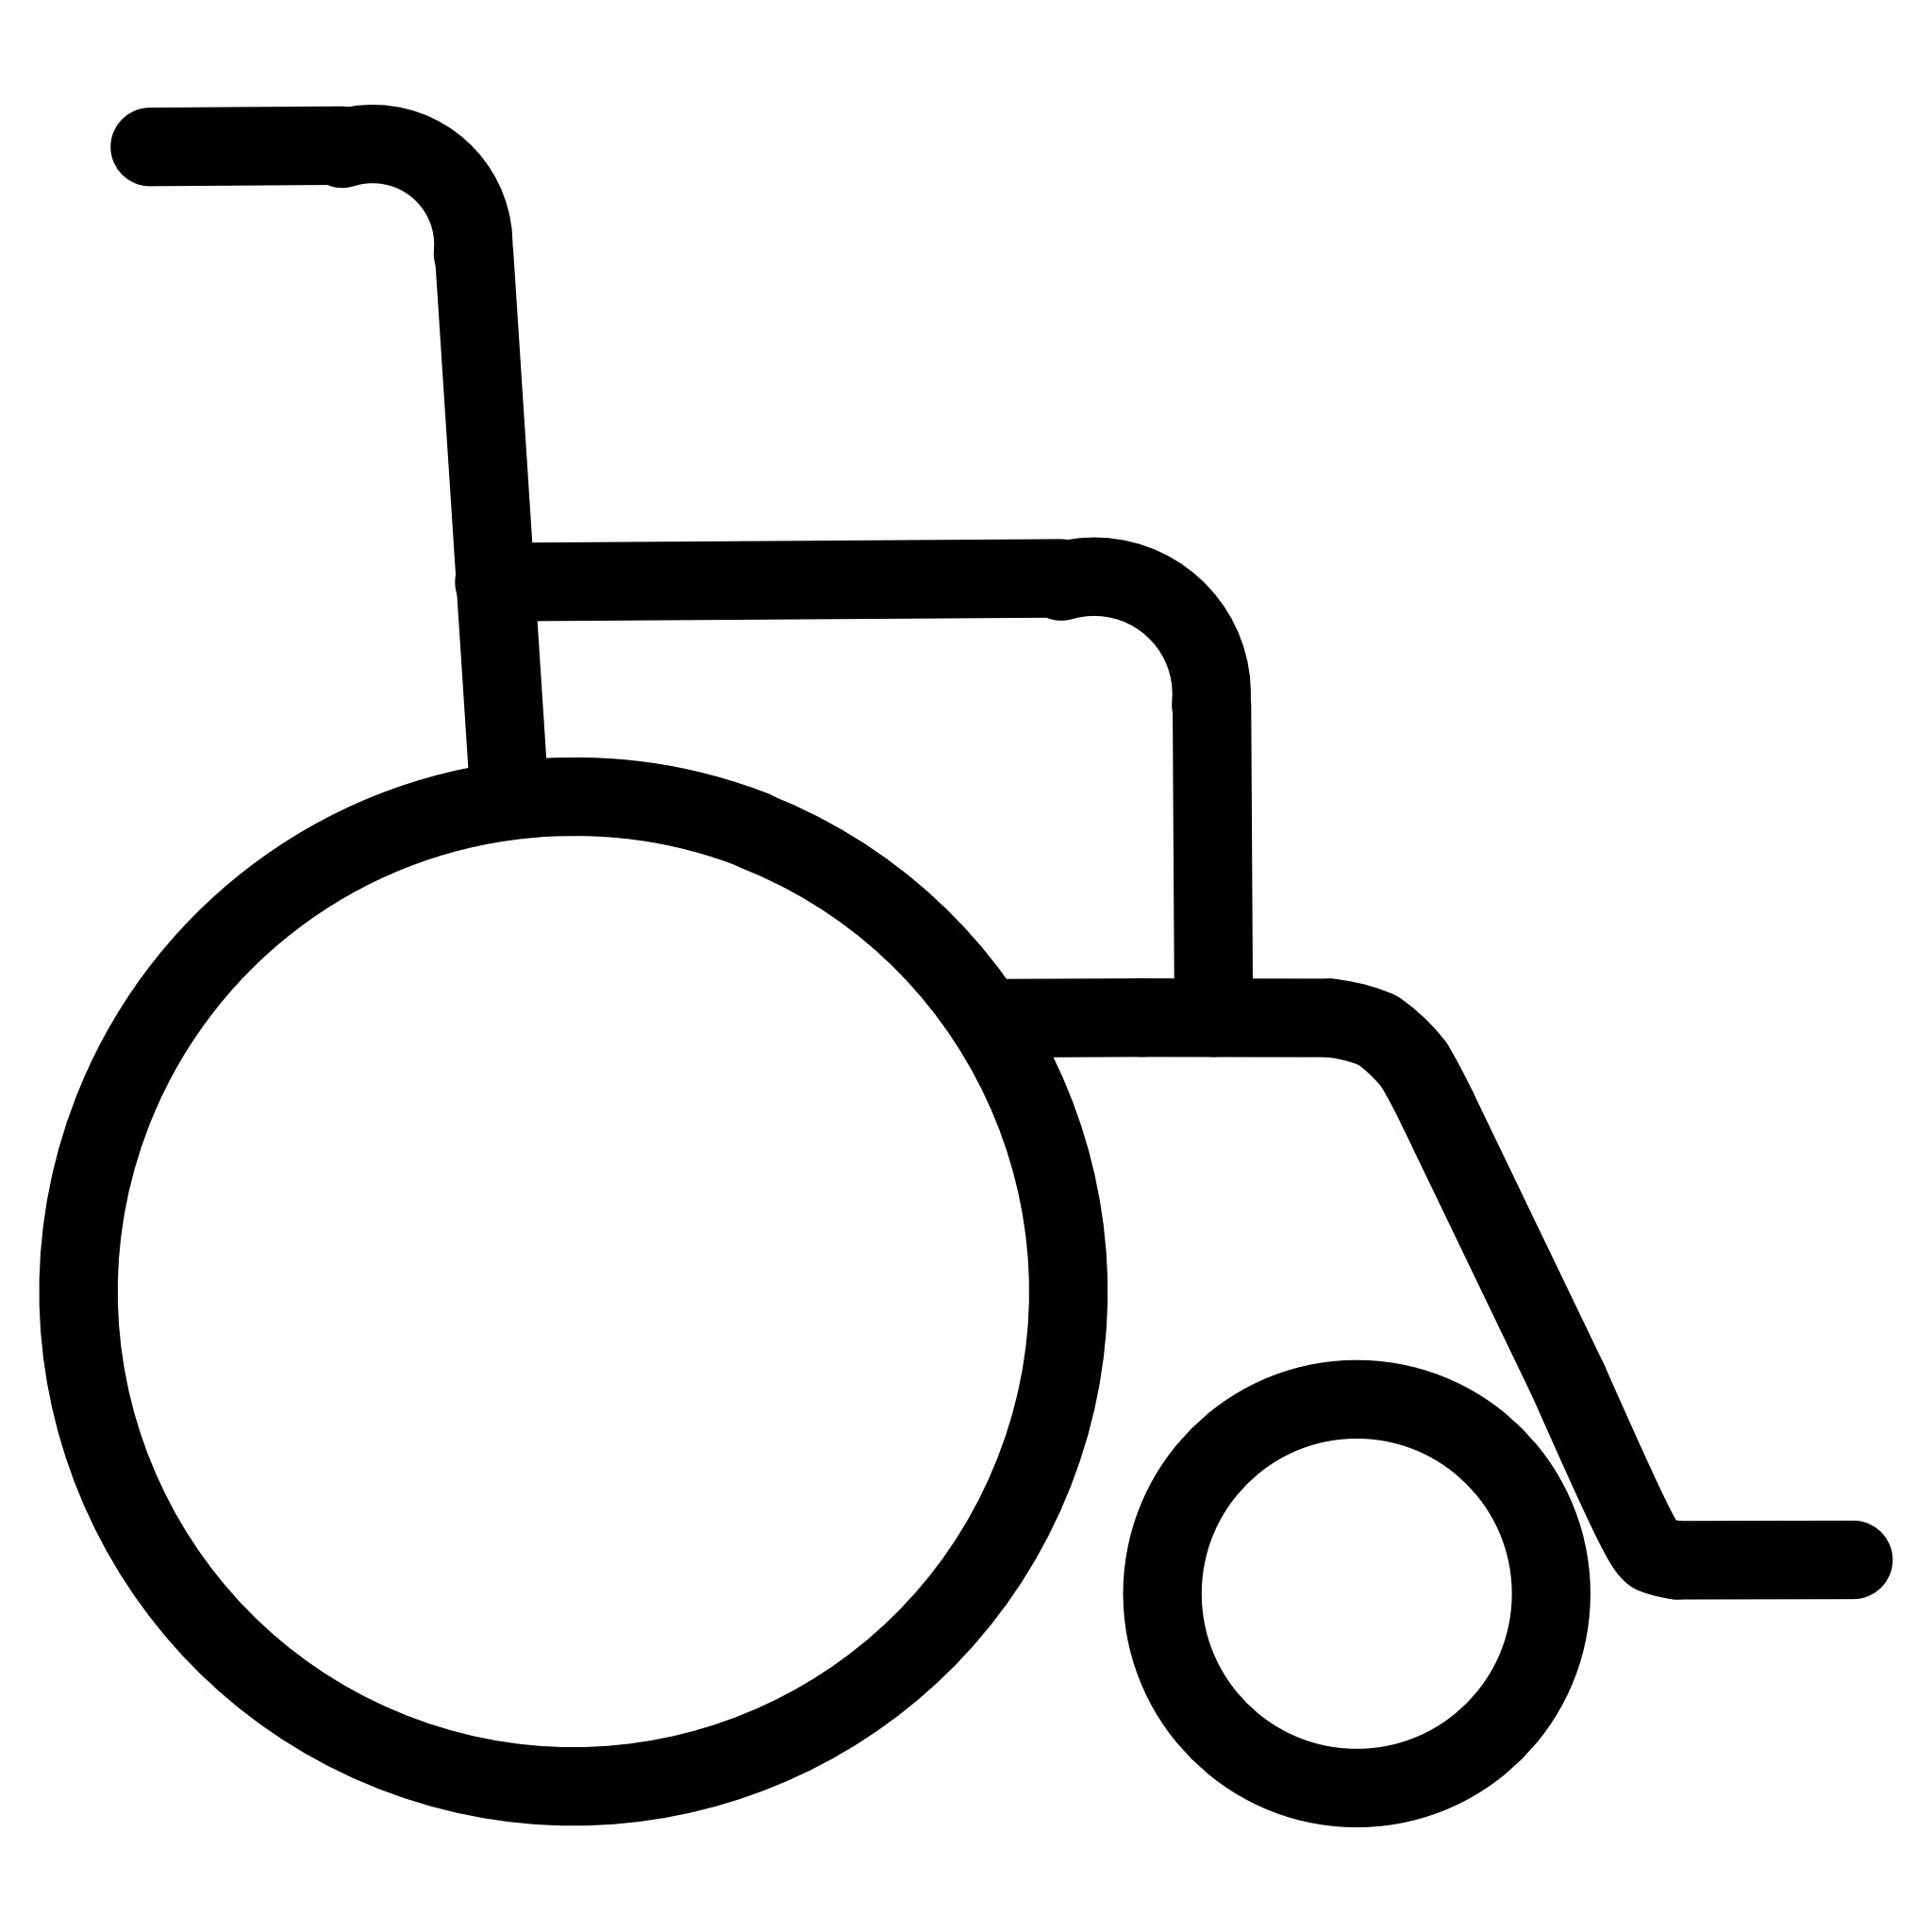



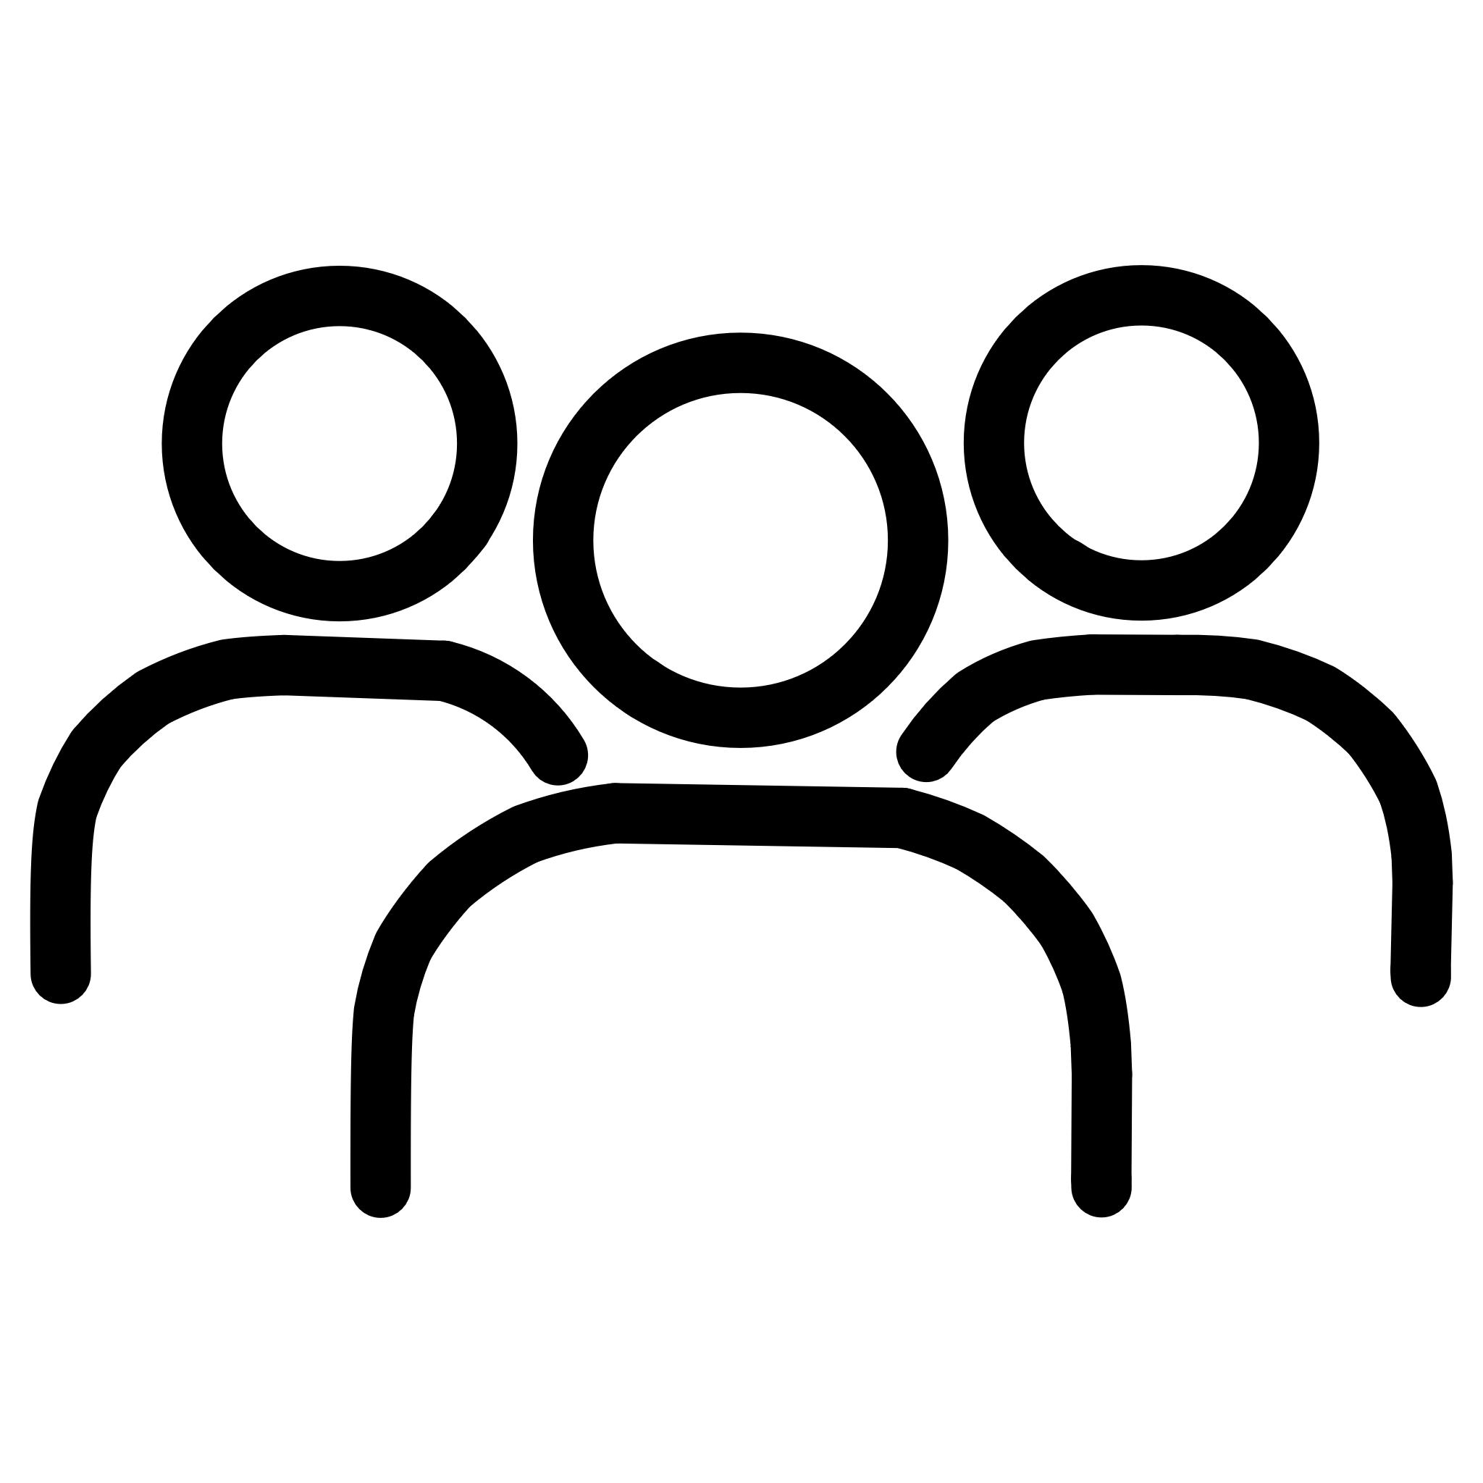
Future Scope ?
VibeDesk is just the beginning. Our vision extends to broader integration and advanced emotional intelligence.
Cross-Platform Expansion
Ecosystem Integration
Advanced Predictions
Browser extension and dedicated mobile applications.
Seamless connectivity with Google Workspace, GitHub, and Notion.
Proactive emotional state forecasting for preventative adaptation.
Offline AI Mode
Team Mood Dashboard
On-device processing for privacy and uninterrupted functionality.
Insights for collaborative teams to optimise group dynamics.
Emotion-intelligent tools are the future of productivity.

Slide 10


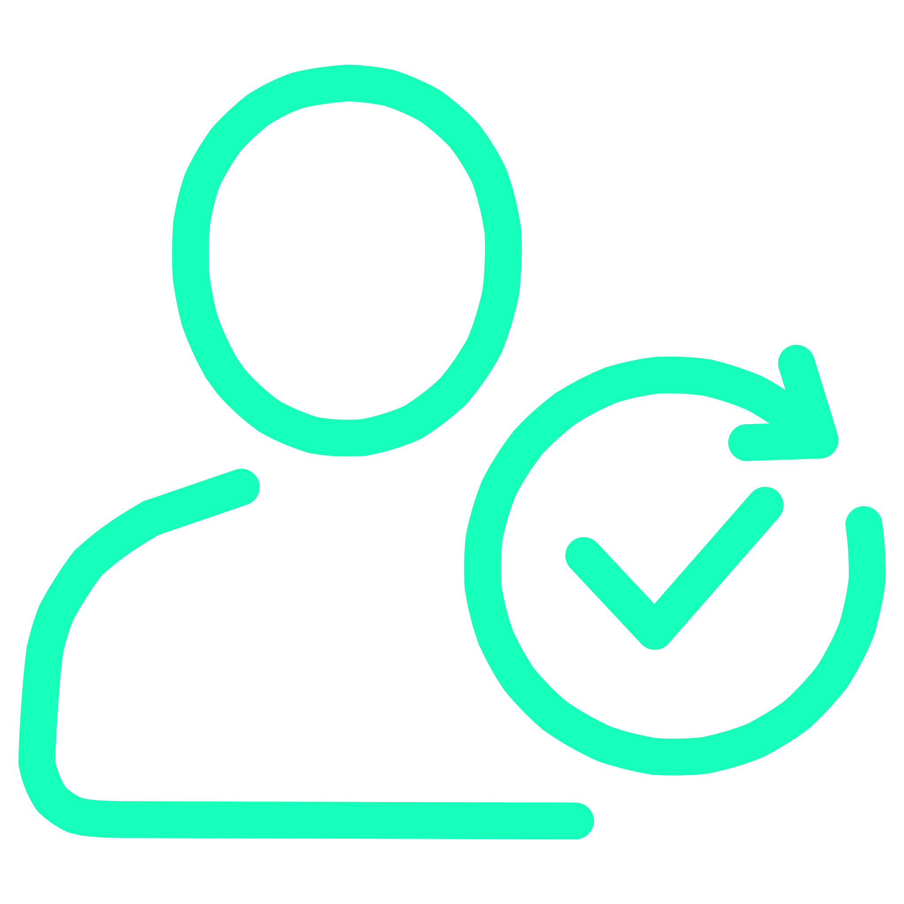
Final Thoughts
VibeDesk bridges the gap between emotions and productivity.
Adaptive Workspace
Enhanced Well-being
Healthier Digital Habits
It transforms a static workspace into a personal, adaptive, emotionally intelligent environment.
It enhances mental well-being, boosts focus, and improves task completion.
Our project demonstrates how AI can create healthier digital habits for students and professionals.

Slide 11
Thank You! 💙✨
Thank you for reviewing our project .
We appreciate your time and feedback.

